Slide 1


SECUREWALA
SecureWala
Fortifying Your Business, One Layer at a Time.

Slide 2

Agenda
Use links to go to a different page inside your presentation.
Highlight text, click on the link symbol on the toolbar, and select the page in your presentation you want to connect.
3 | About the Company
4 | Our Mission and Vision
5 | Our Goals
6 | Our Market
7 | Our Offered Services
8 | Our Milestones
9 | Overview Of The Previous Year
10 | Our Financial Statements
11 | Our Managment Team
13 | Contact Information

Slide 3

About the Company
Secure Wala is a cybersecurity firm offering advanced solutions to protect businesses from digital threats.
Founded in 2022, Secure Wala provides managed security, threat intelligence, penetration testing, and incident response services.
Back to Agenda

Slide 4

Our Mission and Vision
Committed to safeguarding your digital world.
Mission
Vision
To deliver proactive and innovative cybersecurity solutions that protect businesses from evolving digital threats.
To be the trusted leader in cybersecurity, empowering businesses to thrive securely in the digital age.
Back to Agenda

Slide 5



Our Goals
Briefly elaborate on what you want to discuss.
Enhance Cybersecurity Solutions
Expand Client Education
Achieve Leadership
Position Secure Wala as a trusted leader in cybersecurity.
Continuously develop and deliver cutting-edge security services to protect businesses from emerging threats.
Equip clients with tools and knowledge to prevent cyber threats.
Back to Agenda

Slide 6
Our Market
10 Billion
5 Billion
Total Available Market (TAM):
10 Billion
1 Billion
Serviceable Available Market (SAM):
5 Billion
Serviceable Obtainable Market (SOM):
1 Billion
Back to Agenda

Slide 7
Our Offered Services
Managed Security Services (MSS): 24/7 monitoring and management of your network to prevent and detect threats
Penetration Testing: Simulated cyberattacks to identify and fix vulnerabilities in your systems.
Incident Response & Recovery: Rapid response to security breaches, minimizing damage and restoring operations.
Threat Intelligence: Real-time insights and analysis to defend against emerging cyber threats.
Employee Cybersecurity Training: Educational programs to raise awareness and prevent cyberattacks like phishing.
Back to Agenda

Slide 8
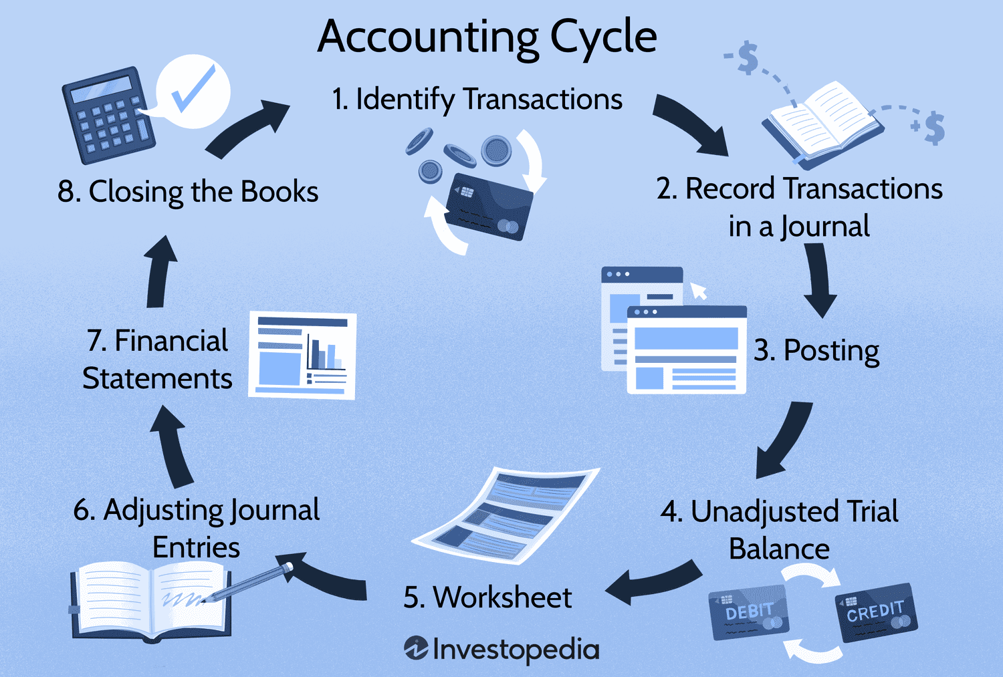
Accounting Cycle
Briefly elaborate on what you want to discuss.
The accounting cycle is the systematic process of identifying, recording, summarizing, and reporting a business's financial transactions, culminating in the preparation of financial statements.
Back to Agenda

Slide 9
Capital budgeting
Briefly elaborate on what you want to discuss.
Monthly Revenue:
$150000
Initially Used Up Capital:
$77,950
Remaining Capital in Hand:
$72,050
Back to Agenda

Slide 10
Capital budgeting
OVERVIEW (FOR THE REMAINING YEAR):
Keeping track for next months based on revenues and expenses, budget will be allocated accordingly to various sectors of employment to effectively keep the business running. This budget will subsequently be adjusted (deducted based on expenses, growth based on income and revenue) accordibly.
Back to Agenda

Slide 11
Financial Statements
Back to Agenda

Slide 12
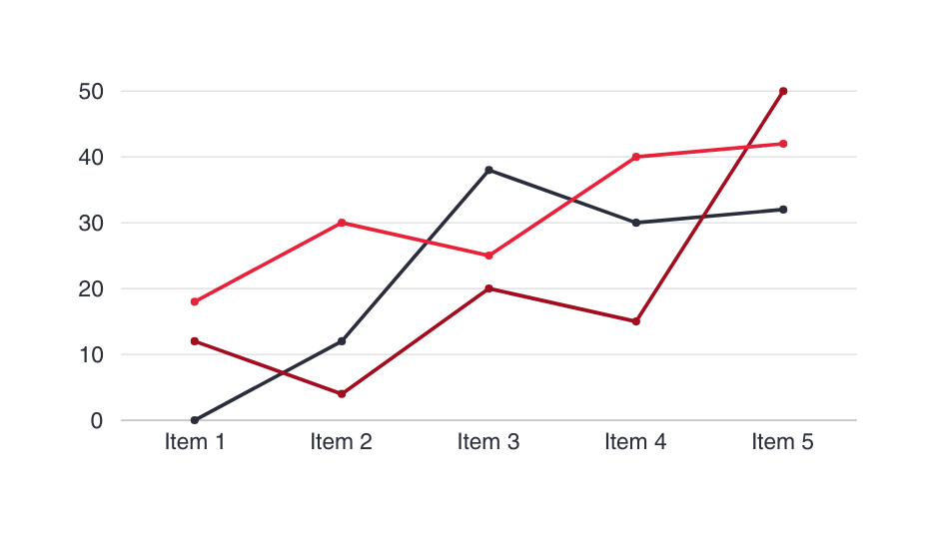
Financial Statements
Briefly elaborate on what you want to discuss.
Monthly Revenue:
10 Billion
Average Revenue/Customer:
$100,000
Monthly Revenue Growth:
50%
Back to Agenda

Slide 13
Financial Statements
Briefly elaborate on what you want to discuss.
Monthly Revenue:
10 Billion
Average Revenue/Customer:
$100,000
Monthly Revenue Growth:
50%
Back to Agenda

Slide 14
Financial Statements
Briefly elaborate on what you want to discuss.
Monthly Revenue:
10 Billion
Average Revenue/Customer:
$100,000
Monthly Revenue Growth:
50%
Back to Agenda

Slide 15





Our Management Team
Shubair Hyder
Chief Executive Officer
Moiz Sheikh
Chief Finance Officer
Zubair Ahmed
Striving For Excellence And Reaching New Heights
Director
Awais Sheikh
Accountant
Zain Saqib
Finance Manager
Back to Agenda

Slide 16

SecureWala
Connect with us.
Email
ContactUs@securewala.com
Instagram
@FutureWithSecurewala
Call us
0900-7860-1

